Slide 1
CSTE-2105 Digital logic design

Slide 2
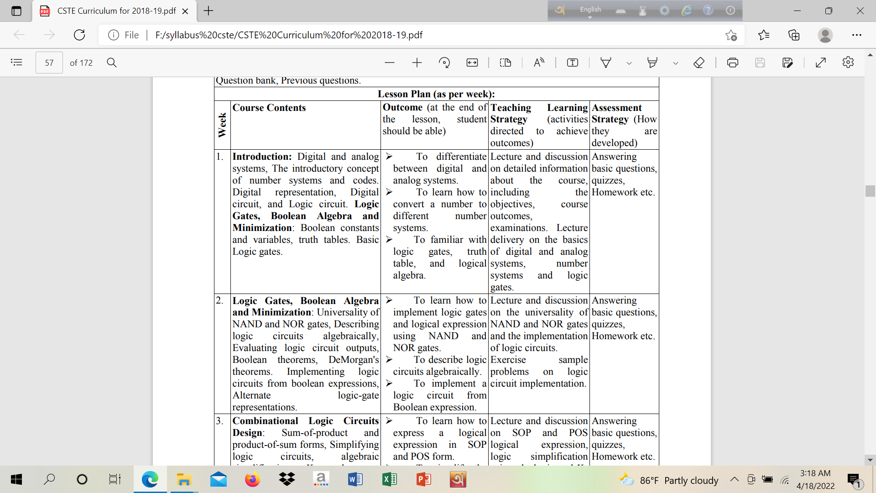

Slide 3
Outline
Digital and analog systems
Number systems and codes

Slide 4
Numerical representations of Quantities
It is important when dealing with various quantities that we be able to represent their values efficiently and accurately.
Basic two ways of representing the numerical value of quantities: analog and digital

Slide 5
Numerical representations of Quantities
Analog: Continuous
Digital: Discrete (step by step)
Example: Thermometer. Temperature with a mercury is analog quantity. Nearest line selection over a continuous range is digital

Slide 6
Numerical representations of Quantities Example:
Ten position switch (D)
Current flowing from an electrical outlet (A)
Temperature of a room (A)
Sand grains on the beach (D)
Automobile fuel gauge (A/D)

Slide 7
Digital and analog Details
Book reference: Digital Systems by Ronald J. Tocci

Slide 8
Digital and analog Details (Home work)
Questions:
Advantages of digital techniques over analog.
Limitations of digital technique.
Conversion steps from analog-digital-analog.

Slide 9
Number system
Decimal number system is the most common number system. Other popular number systems include binary number system, octal number system, hexadecimal number system, etc.

Slide 10
Decimal number system
Decimal number system is a base 10 number system having 10 digits from 0 to 9. This means that any numerical quantity can be represented using these 10 digits. Decimal number system is also a positional value system. This means that the value of digits will depend on its position.
Say we have three numbers – 734, 971 and 207. The value of 7 in all three numbers is different−
In 734, value of 7 is 7 hundreds or 700 or 7 × 100 or 7 × 10²
In 971, value of 7 is 7 tens or 70 or 7 × 10 or 7 × 10¹
In 207, value 0f 7 is 7 units or 7 or 7 × 1 or 7 × 10⁰

Slide 11

Decimal number system
The weightage of each position can be represented as follows −

Slide 12
Decimal number system
In digital systems, instructions are given through electric signals; variation is done by varying the voltage of the signal. Having 10 different voltages to implement decimal number system in digital equipment is difficult. So, many number systems that are easier to implement digitally have been developed.

Slide 13
Binary number system
The easiest way to vary instructions through electric signals is two-state system – on and off. On is represented as 1 and off as 0, though 0 is not actually no signal but signal at a lower voltage. The number system having just these two digits : 0 and 1 is called binary number system.
Each binary digit is also called a bit. Binary number system is also positional value system, where each digit has a value expressed in powers of 2.

Slide 14

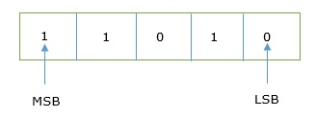
Binary number system
In any binary number, the rightmost digit is called least significant bit (LSB) and leftmost digit is called most significant bit (MSB).

Slide 15
Binary number system
…and decimal equivalent of this number is sum of product of each digit with its positional value.
11010₂ = 1×2⁴ + 1×2³ + 0×2² + 1×2¹ + 0×2⁰
= 16 + 8 + 0 + 2 + 0
= 26₁₀
Computer memory is measured in terms of how many bits it can store. Here is a chart for memory capacity conversion.
1 byte (B) = 8 bits
1 Kilobytes (KB) = 1024 bytes
1 Megabyte (MB) = 1024 KB
1 Gigabyte (GB) = 1024 MB
1 Terabyte (TB) = 1024 GB
1 Exabyte (EB) = 1024 TB
1 Zettabyte = 1024 EB
1 Yottabyte (YB) = 1024 ZB

Slide 16

Octal number system
Octal number system has eight digits – 0, 1, 2, 3, 4, 5, 6 and 7. Octal number system is also a positional value system with where each digit has its value expressed in powers of 8, as shown here −Decimal equivalent of any octal number is sum of product of each digit with its positional value.
726₈ = 7×8² + 2×8¹ + 6×8⁰
= 448 + 16 + 6
= 470₁₀

Slide 17

Hexadecimal number system
Hexadecimal number system has 16 symbols – 0 to 9 and A to F where A is equal to 10, B is equal to 11 and so on till F. Hexadecimal number system is also a positional value system with where each digit has its value expressed in powers of 16
27FA₁₆ = 2×16³ + 7×16² + 15×16¹ + 10×16⁰
= 8192 + 1792 + 240 +10
= 10234₁₀

Slide 18
Relationship among number systems
HEXADECIMAL | DECIMAL | OCTAL | BINARY
0 | 0 | 0 | 0000
1 | 1 | 1 | 0001
2 | 2 | 2 | 0010
3 | 3 | 3 | 0011
4 | 4 | 4 | 0100
5 | 5 | 5 | 0101
6 | 6 | 6 | 0110
7 | 7 | 7 | 0111
8 | 8 | 10 | 1000
9 | 9 | 11 | 1001
A | 10 | 12 | 1010
B | 11 | 13 | 1011
C | 12 | 14 | 1100
D | 13 | 15 | 1101
E | 14 | 16 | 1110
F | 15 | 17 | 1111
The following table depicts the relationship between decimal, binary, octal and hexadecimal number systems.

